Slide 1
E-notes of
Sem: 3rd Sem Mech. Engg.
Subject: Mech. Engg. Drawing
Anil Kumar Yadav
HOD. Mech. Engg.
BKN GOVT POLYTECHNIC NARNAUL

Slide 2
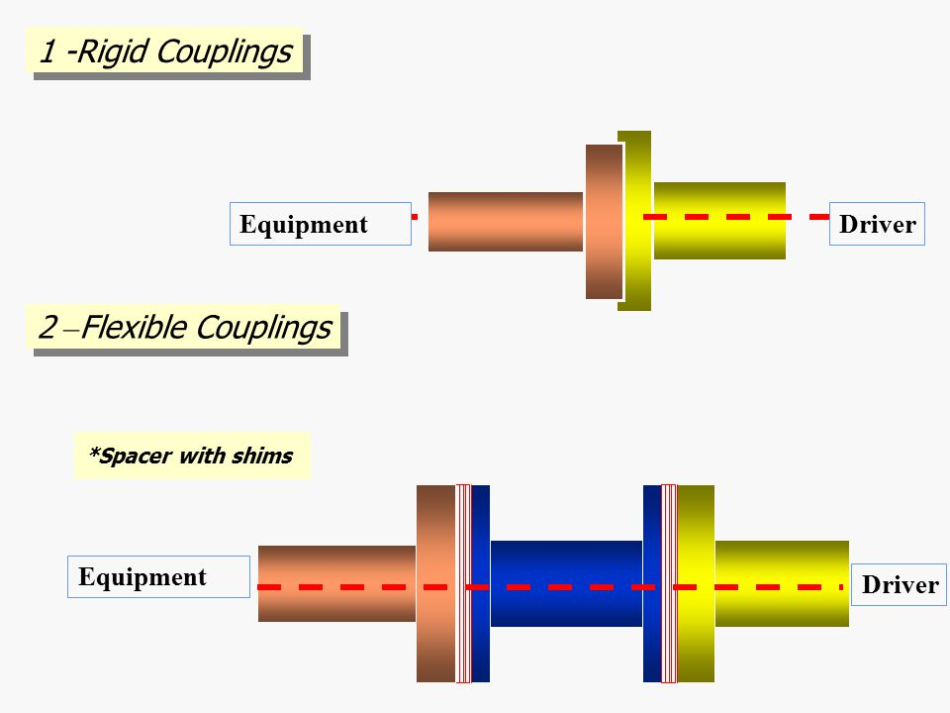
Couplings
Couplings are mechanical elements that ‘couples’ two drive elements (shafts) which enables motion to be transferred from one element to another.
Shaft couplings are divided into two main groups.
1) Rigid coupling-: It is used to connect two shafts which are perfectly aligned.
2) Flexible coupling Flexible couplings are used to transmit torque from one shaft to another when the two shafts having both lateral and angular misalignment

Slide 3
Classification of Couplings
RIGID COUPLING
Sleeve or Muff Coupling
Clamp Coupling
FLEXIBLE COUPLING
Universal Coupling
Oldham’s Coupling
Flange Coupling
Bushed Pin Type Coupling

Slide 4
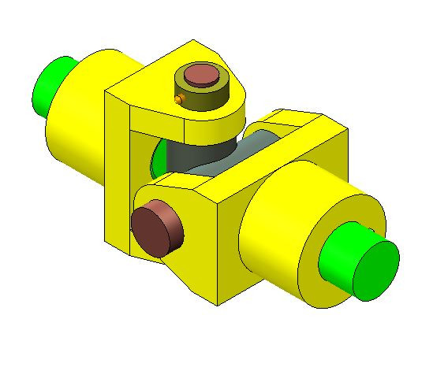
Universal Coupling
A universal coupling, universal joint, U-joint or Hooke's joint is a joint or coupling in a rigid rod that allows the rod to 'bend' in any direction, and is commonly used in shafts that transmit rotary motion.

Slide 5
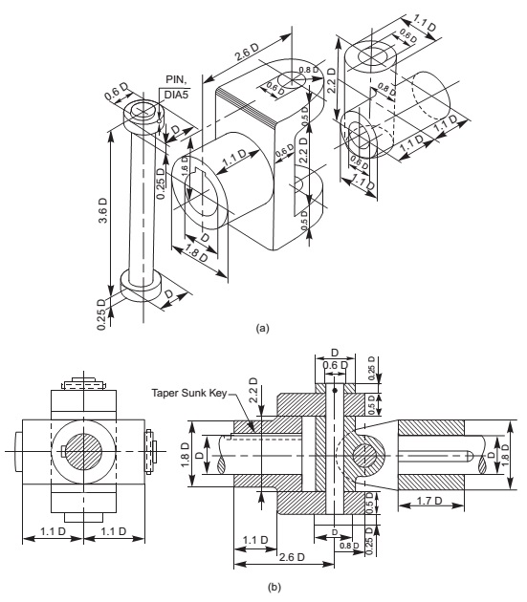

Slide 6
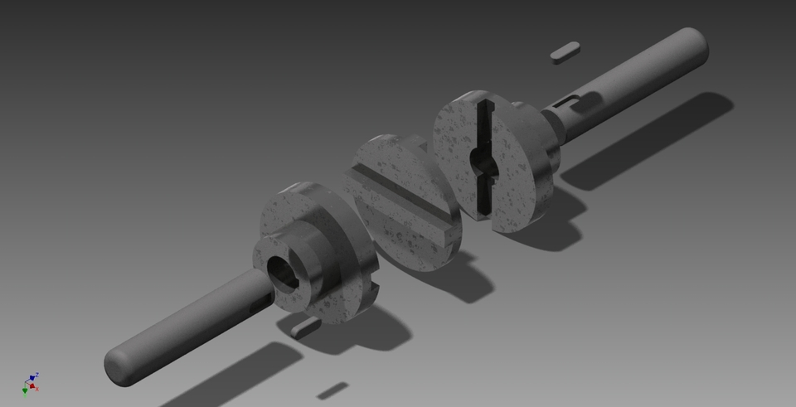
Oldham’s Coupling
An Oldham coupling has three discs, one coupled to the input, one coupled to the output, and a middle disc that is joined to the first two by tongue and groove.

Slide 7

Assembly of Oldham’s Coupling

Slide 8
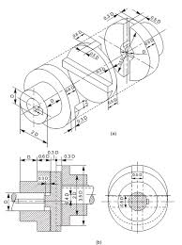

Slide 9
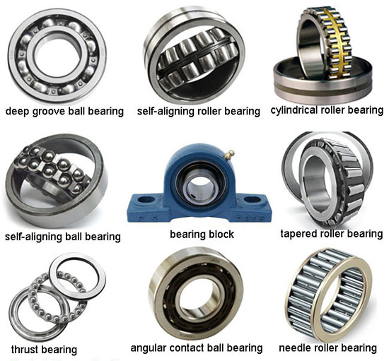
Bearings
A bearing is a machine element that constrains relative motion to only the desired motion, and reduces friction between moving parts.

Slide 10
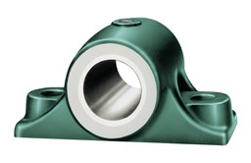
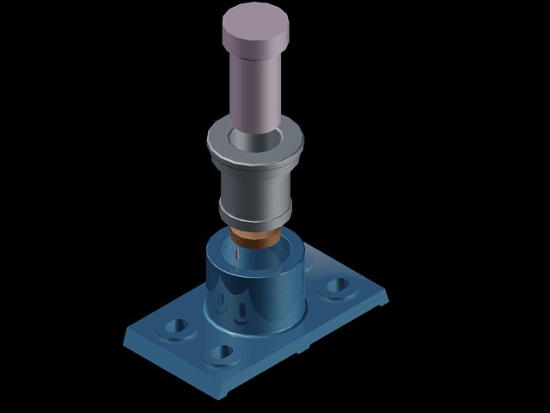
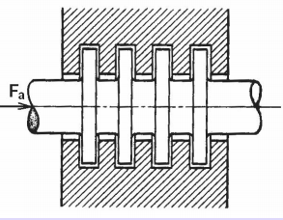
BEARINGS CLASSIFICATION
JOURNAL BEARINGS
FOOT-STEP BEARINGS
COLLAR (THRUST) BEARINGS

Slide 11
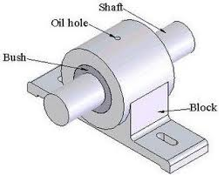
BUSH BEARINGS
An independent plain bearing that is inserted into a housing to provide a bearing surface for rotary applications; this is the most common form of a plain bearing.

