Slide 1
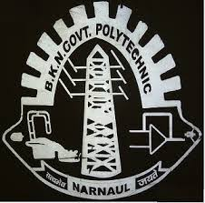
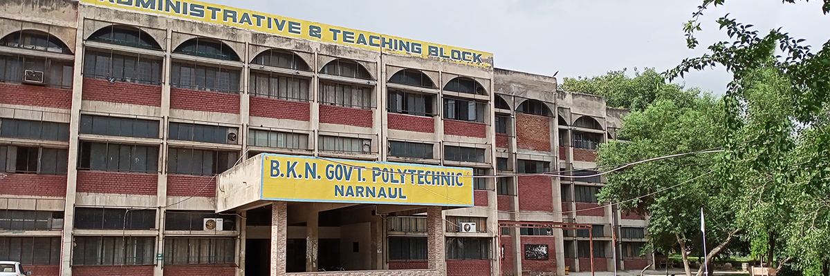
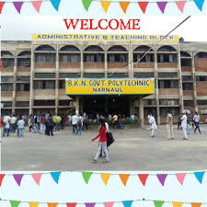
Workshop Technology-II
E-notes of
Name-Kapil Yadav
Designation-Lecturer
Deptt.-Mechanical Engg.
B.K.N. Govt. Polytechnic, Narnaul

Slide 2
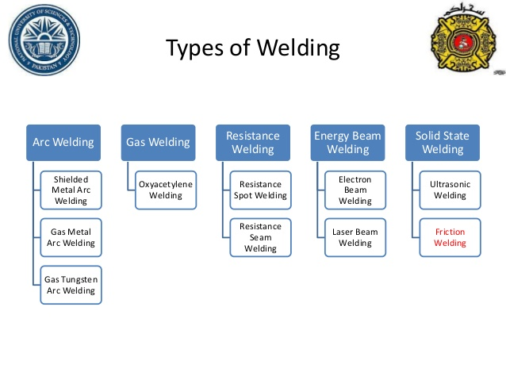
Welding:- Welding is a fabrication process whereby two or more parts are fused together by means of heat, pressure or both forming a join as the parts cool. Welding is usually used on metals and thermoplastics but can also be used on wood. The completed welded joint may be referred to as a weldment.

Slide 3
Common Welding Joints
Butt Joint
A connection between the ends or edges of two parts making an angle to one another of 135-180° inclusive in the region of the joint.
T Joint
A connection between the end or edge of one part and the face of the other part, the parts making an angle to one another of more than 5 up to and including 90° in the region of the joint.
Corner Joint
A connection between the ends or edges of two parts making an angle to one another of more than 30 but less than 135° in the region of the joint.
Edge Joint
A connection between the edges of two parts making an angle to one another of 0 to 30° inclusive in the region of the joint.
Cruciform Joint
A connection in which two flat plates or two bars are welded to another flat plate at right angles and on the same axis.
Lap Joint
A connection between two overlapping parts making an angle to one another of 0-5° inclusive in the region of the weld or welds.

Slide 4
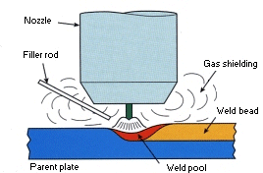
Tungsten Inert Gas (TIG) welding, also known as Gas Tungsten Arc Welding (GTAW) is an arc welding process that produces the weld with a non-consumable tungsten electrode.
In the TIG welding process the arc is formed between a pointed tungsten electrode and the workpiece in an inert atmosphere of argon or helium. The small intense arc provided by the pointed electrode is ideal for high quality and precision welding. Because the electrode is not consumed during welding, the TIG welder does not have to balance the heat input from the arc as the metal is deposited from the melting electrode. When filler metal is required, it must be added separately to the weldpool.

Slide 5
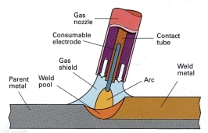
Metal Inert Gas (MIG) welding is an arc welding process that uses a continuous solid wire electrode heated and fed into the weld pool from a welding gun. The two base materials are melted together forming a join. The gun feeds a shielding gas alongside the electrode helping protect the weld pool from airborne contaminants.
MIG/MAG welding is a versatile technique suitable for both thin sheet and thick section components. An arc is struck between the end of a wire electrode and the workpiece, melting both of them to form a weld pool. The wire serves as both heat source (via the arc at the wire tip) and filler metal for the welding joint. The wire is fed through a copper contact tube (contact tip) which conducts welding current into the wire. The weld pool is protected from the surrounding atmosphere by a shielding gas fed through a nozzle surrounding the wire. Shielding gas selection depends on the material being welded and the application. The wire is fed from a reel by a motor drive, and the welder moves the welding torch along the joint line. Wires may be solid (simple drawn wires), or cored (composites formed from a metal sheath with a powdered flux or metal filling). Consumables are generally competitively priced compared with those for other processes. The process offers high productivity, as the wire is continuously fed.

Slide 6
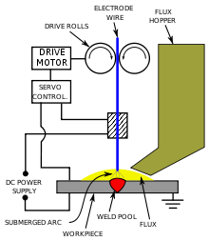
Submerged-arc welding (SAW) is a common arc welding process that involves the formation of an arc between a continuously fed electrode and the workpiece. A blanket of powdered flux generates a protective gas shield and a slag (and may also be used to add alloying elements to the weld pool) which protects the weld zone.

Slide 7
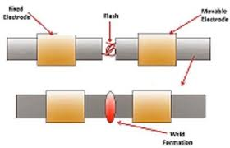
Spot welding (or resistance spot welding) is a type of electric resistance welding used to weld various sheet metal products, through a process in which contacting metal surface points are joined by the heat obtained from resistance to electric current.
The process uses two shaped copper alloy electrodes to concentrate welding current into a small "spot" and to simultaneously clamp the sheets together. Work-pieces are held together under pressure exerted by electrodes. Typically the sheets are in the 0.5 to 3 mm (0.020 to 0.118 in) thickness range. Forcing a large current through the spot will melt the metal and form the weld. The attractive feature of spot welding is that much energy can be delivered to the spot in a very short time (approximately 10–100 milliseconds).^{[2]} That permits the welding to occur without excessive heating of the remainder of the sheet.

Slide 8
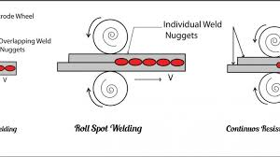
Resistance Seam Welding
For producing a force-transmitting point sequence, or for the production gas or fluid-tight seams, the seam welding is used (Figure 47). When seam welding in certain distances from each, arranged spot welds are made. The roll-shaped rotating electrode, and by a pulse-type power supply, the welding points are generated at equal intervals. The current in short successive pulses, i.e., supplied almost continuously, then creating overlapping weld points, leading to a liquid- or gas-tight seam. It is advantageous that the rotation of the electrode, the current transition always at a different location, is creating a life extension. There is, however, a considerable portion of the stream running through the already formed seam, forming a shunt. In relation to the spot welding, therefore, much higher currents are required. This makes it necessary to cool the rollers with water.

Slide 9
Pattern & Pattern making:- pattern is a template from which part of a garment is traced onto the fabric before being cut out and assembled; patterns are usually made of paper. Pattern Making is a blueprint for the garment, on the basis of which the fabric is cut. It is the technical drawing or drafting of a garment. Standard size charts, dress forms or figure are measured, these measurements are then converted into 2D patterns and then garments are made from them.
Pattern Making has become necessary for a Fashion designer to enable him to make different garments. Pattern Making is very interesting and important for a student as it helps to interpret Designs and understand it with technical ability.
There are many methods of Pattern Making. Flat Pattern Making and Draping are the common ones. In Flat Pattern Making, we take the accurate measurements from a dress form or a figure and then measurements are turned into a pattern using paper. In Draping, a specific Design is achieved, Muslin fabric is draped around a dress form or figure to achieve specific Design.
Functions of Pattern:
These are some functions of a Pattern:
It is used for preparing a mold cavity which is used for Casting any parts.
Some accurate pattern can minimize the production cost of a product because of no further machining is required.
It reduces casting defects.

Slide 10
Materials Used for Pattern:
Some key factors are in mind before choosing a material for the pattern:
The materials used in the pattern should be cheap in cost and easily available in the market.
The material should have a good surface finish.
The material should have withstood high temperatures and does not change its shape at high temperatures.
Generally, we use 5 different types of material to make the patter and those are:
Wood
Metals
Plaster of Paris
Plastics
Wax

Slide 11
Different types of patterns:
The common types of patterns are:
1) Single piece pattern
2) Split piece pattern
3) Loose piece pattern
4) Gated pattern
5) Match pattern
6) Sweep pattern
7) Cope and drag pattern
8) Skeleton pattern
9) Shell pattern
10) Follow board pattern

Slide 12
Molding or moulding is the process of manufacturing by shaping liquid or pliable raw material using a rigid frame called a mold or matrix. This itself may have been made using a pattern or model of the final object.
A mold or mould is a hollowed-out block that is filled with a liquid or pliable material such as plastic, glass, metal, or ceramic raw material. The liquid hardens or sets inside the mold, adopting its shape. A mold is the counterpart to a cast. The very common bi-valve molding process uses two molds, one for each half of the object. Articulated molds have multiple pieces that come together to form the complete mold, and then disassemble to release the finished casting; they are expensive, but necessary when the casting shape has complex overhangs.

Slide 13
Cupola furnace:-
A small cupola furnace in operation at Wayne State University, in Detroit, Michigan.
A cupola or cupola furnace is a melting device used in foundries that can be used to melt cast iron, Ni-resist iron and some bronzes. The cupola can be made almost any practical size. The size of a cupola is expressed in diameters and can range from 1.5 to 13 feet (0.5 to 4.0 m).^{[1]} The overall shape is cylindrical and the equipment is arranged vertically, usually supported by four legs. The overall look is similar to a large smokestack.
The bottom of the cylinder is fitted with doors which swing down and out to 'drop bottom'. The top where gases escape can be open or fitted with a cap to prevent rain from entering the cupola. To control emissions a cupola may be fitted with a cap that is designed to pull the gases into a device to cool the gases and remove particulate matter.
The shell of the cupola, being usually made of steel, has refractory brick and plastic^{[note 1]} refractory patching material lining it. The bottom is lined in a similar manner but often a clay and sand mixture ("bod") may be used, as this lining is temporary. Finely divided coal ("sea coal") can be mixed with the clay lining so when heated the coal decomposes and the bod becomes slightly friable, easing the opening up of the tap holes.^{[3]} The bottom lining is compressed or 'rammed' against the bottom doors. Some cupolas are fitted with cooling jackets to keep the sides cool and with oxygen injection to make the coke fire burn hotter.

Slide 14
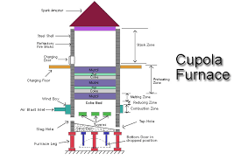

Slide 15
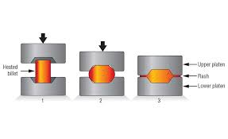
Forging is a manufacturing process involving the shaping of a metal through hammering, pressing, or rolling. These compressive forces are delivered with a hammer or die. Forging is often categorized according to the temperature at which it is performed—cold, warm, or hot forging. A wide range of metals can be forged.

Slide 16
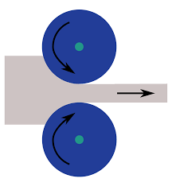
In metalworking, rolling is a metal forming process in which metal stock is passed through one or more pairs of rolls to reduce the thickness and to make the thickness uniform. The concept is similar to the rolling of dough. Rolling is classified according to the temperature of the metal rolled.

Slide 17
