Slide 1
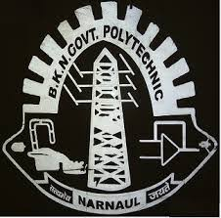
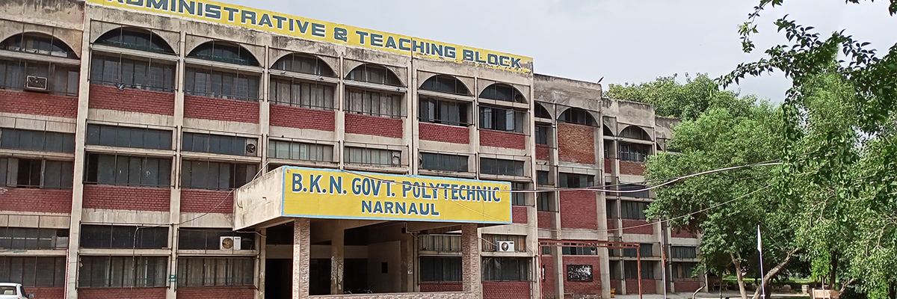

Refrigeration & Air Conditioning
E-notes of
Name-Kapil Yadav & Vineet Sharma
Designation-Lecturer
Deptt.-Mechanical Engg.
B.K.N. Govt. Polytechnic, Narnaul

Slide 2
The term refrigeration means cooling a space, substance or system to lower and/or maintain its temperature below the ambient one (while the removed heat is rejected at a higher temperature). In other words, refrigeration is artificial (human-made) cooling.
Air conditioning (often referred to as AC, A/C, or air con) is the process of removing heat and moisture from the interior of an occupied space to improve the comfort of occupants. ... In construction, a complete system of heating, ventilation, and air conditioning is referred to as HVAC.

Slide 3
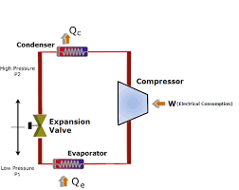
Vapour-compression refrigeration or vapor-compression refrigeration system (VCRS),^{[1]} in which the refrigerant undergoes phase changes, is one of the many refrigeration cycles and is the most widely used method for air-conditioning of buildings and automobiles. It is also used in domestic and commercial refrigerators, large-scale warehouses for chilled or frozen storage of foods and meats, refrigerated trucks and railroad cars, and a host of other commercial and industrial services. Oil refineries, petrochemical and chemical processing plants, and natural gas processing plants are among the many types of industrial plants that often utilize large vapor-compression refrigeration systems. Cascade refrigeration systems may also be implemented using 2 compressors.

Slide 4
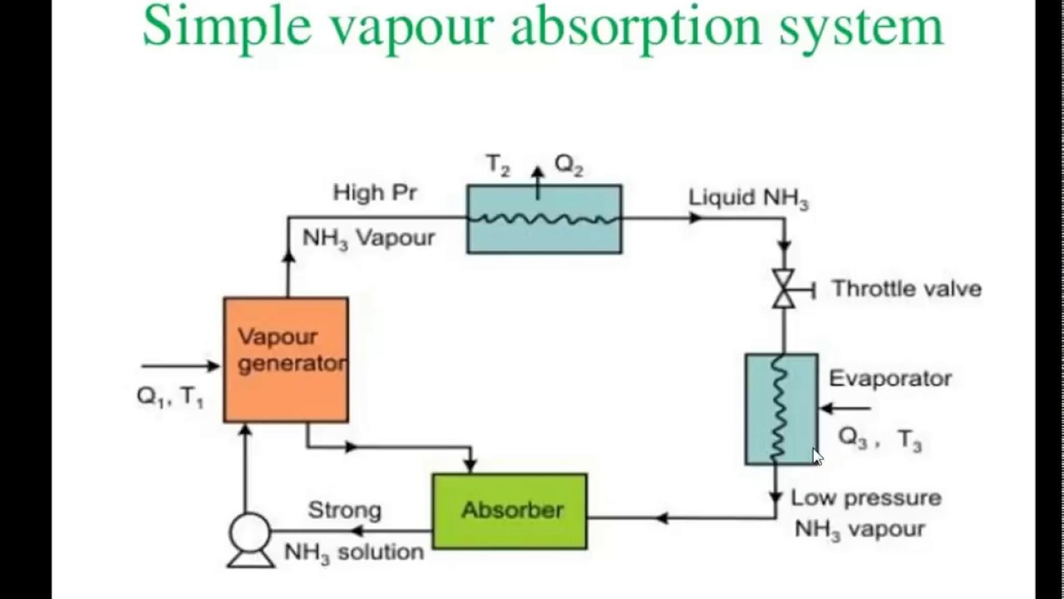
An absorption refrigerator is a refrigerator that uses a heat source (e.g., solar energy, a fossil-fueled flame, waste heat from factories, or district heating systems) to provide the energy needed to drive the cooling process. The system uses two coolants, the first of which performs evaporative cooling and is then absorbed into the second coolant; heat is needed to reset the two coolants to their initial states. The principle can also be used to air-condition buildings using the waste heat from a gas turbine or water heater. Using waste heat from a gas turbine makes the turbine very efficient because it first produces electricity, then hot water, and finally, air-conditioning—trigeneration. Absorption refrigerators are commonly used in recreational vehicles (RVs), campers, and caravans because they can be powered with propane fuel, rather than electricity. Unlike more common vapor-compression refrigeration systems, an absorption refrigerator can be produced with no moving parts other than the coolants.

Slide 5
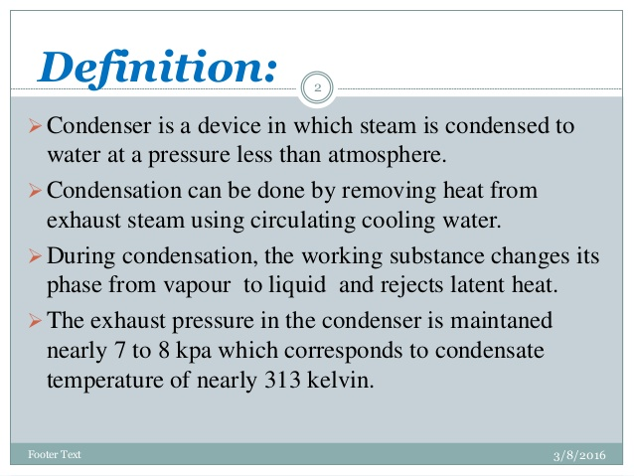

Slide 6
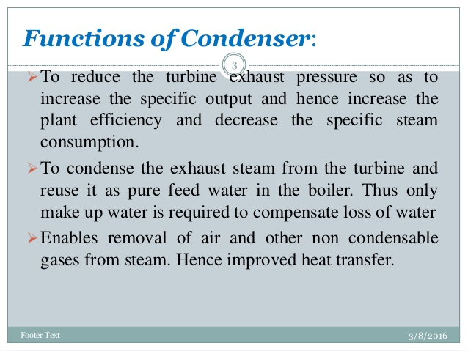

Slide 7
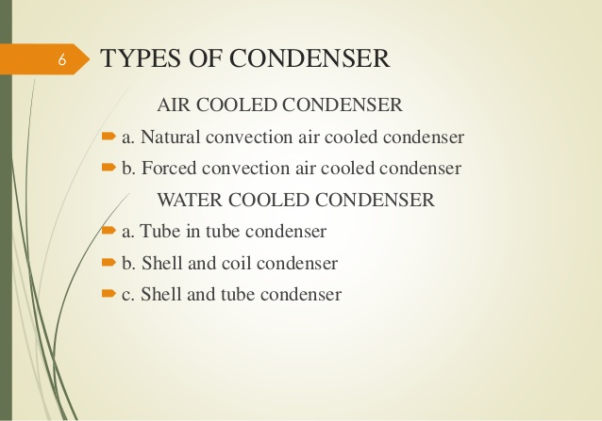

Slide 8
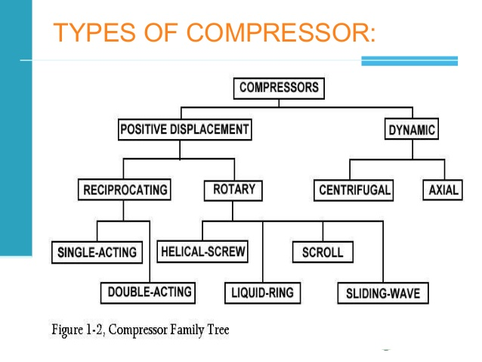

Slide 9
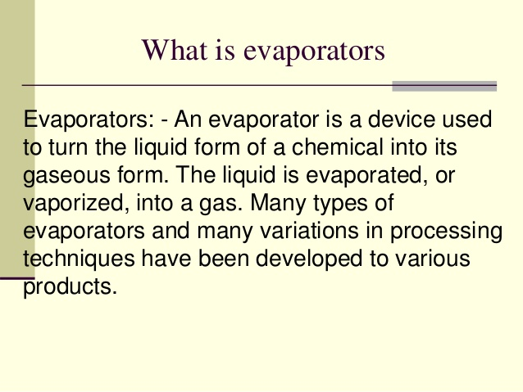

Slide 10
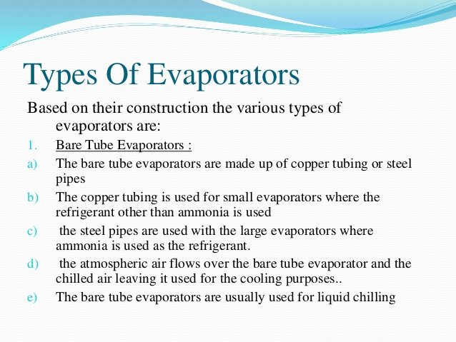

Slide 11
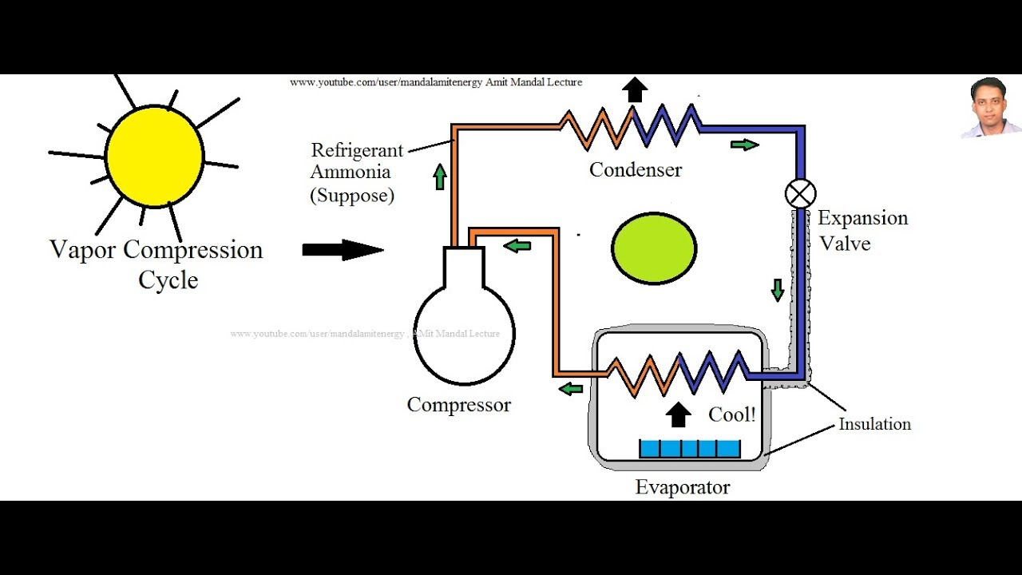
solar-powered refrigerator is a refrigerator which runs on energy directly provided by sun, and may include photovoltaic or solar thermal energy.
Solar-powered refrigerators are able to keep perishable goods such as meat and dairy cool in hot climates, and are used to keep much needed vaccines at their appropriate temperature to avoid spoilage.
Solar-powered refrigerators are typically used in off-the-grid locations where utility provided AC power is not available.

Slide 12
Types of Refrigerants
Refrigerants used in industrial spaces
Here we bring you a list of refrigerants that are majorly adopted for industrial refrigeration plants.
Water
Water is one of the substances filled with perfect chemical and thermodynamic properties. It has been used as a type of refrigerant for decades due to its easy availability. Well, it can’t be considered to be a refrigerant alone, but when chilled in cooling plants, it is put to use in the circuits for lowering the temperatures.
For using water as a refrigerant, there is a need for ambient temperature that is higher than 100° C.
HFC R134A
This refrigerant is used in air-conditioned cars but also put to use in commercial refrigerant spaces in refrigerant piping. While talking about its features, it is enriched with minimal toxicity, non-combustibility, flawless thermal stability, and non-corrosiveness.
Hydrocarbons (HCS)
This refrigerant is filled with chemicals that are used in commercial refrigeration systems, air conditioning systems, and domestic refrigeration systems. This refrigerant is apt for industrial cooling as it has propane with zero ODP (Ozone depletion potential). But it needs specific safety installations.
While working with Hydrocarbons, keep certain things in mind for better operation such as avoiding welding in the same area, and staying away from sparks and wire.

Slide 13
Ammonia (R717)
Ammonia is considered to be the oldest and most commonly used refrigerant in industrial cooling plants. It is power-packed with halogen-free chemicals. Here, the application process is in smaller components thereafter eradicating the need for big cooling plants.
Besides, it has a lower molecular weight, high critical points, and a high coefficient of performance, but with this comes the damaging effects.
CO2 R744
This refrigerant has to be handled with care due to its heavyweight, while in a situation of leakage it might replace oxygen. On the brighter side, CO2 R744 has a minimum impact on the environment as it is non-toxic and non-flammable.

Slide 14
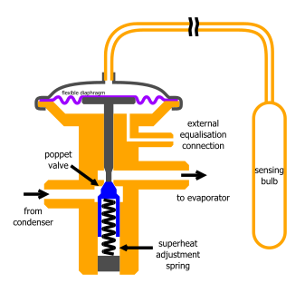
A thermal expansion valve or thermostatic expansion valve (often abbreviated as TEV, TXV, or TX valve) is a component in refrigeration and air conditioning systems that controls the amount of refrigerant released into the evaporator and is intended to regulate the superheat of the vapor leaving the evaporator. Although often described as a "thermostatic" valve, an expansion valve does not regulate temperature, the temperature of the evaporator will vary with the evaporation pressure.

Slide 15
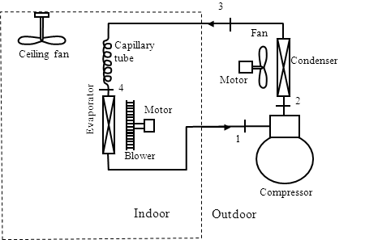
A split air conditioner consists of two main parts – a compressor located outside and an inside air outlet unit. Unlike a system that requires a series of ductwork networked throughout the ceiling, split air conditioners rely on a set of pipes to connect the outdoor to the inside air unit which is why there are referred to as a ductless mini-split air conditioner installation. Refrigerant is dispersed through the copper pipes that cycle through the system to generate either heated or cold air.

